Slide 1
GAN –Variant's

Slide 2
Building GAN where we are able to control the output so called conditional GAN
Motivation for CGAN

Slide 3
Compare GAN vs CGAN
The CGAN will pass extra information to the generator and critic relating to the label
In the generator this is simply appended to the latent space sample as a one hot encoded vector.
In the critic we add the label information as extra channel's to the RGB image. We do this by repeating the one hot encoded vector to fill the sample shape as the input images
CGAN work because the critic now has access to extra
information regarding the content of the image so the
generator must ensure that its output agrees with
the provided label in order to fool critic.
If the generator produced perfect images that disagreed
With the image label the critic would be able to tell that
They were fake simply because the images and labels
did not match.

Slide 4
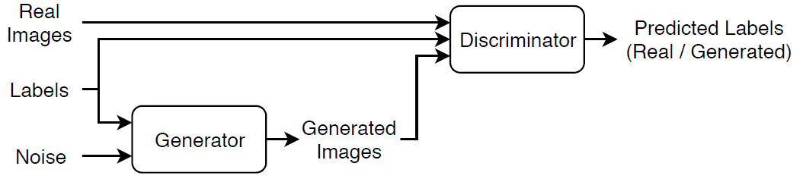
Conditional GAN
A conditional generative adversarial network (CGAN) is a type of GAN that also takes advantage of labels during the training process.
Generator — Given a label and random array as input, this network generates data with the same structure as the training data observations corresponding to the same label.
Discriminator — Given batches of labeled data containing observations from both the training data and generated data from the generator, this network attempts to classify the observations as "real" or "generated".

Slide 5
Note
Analysis of CGAN
We keep the random latent vector same across the examples and change only the conditional label vector
For e.g. [1,0] generate face with nonblond hair
[0,1] face with blond hair
CGAN is able to control only hair attribute of the image using label vector
Fashion MNIST dataset : 10 different fashion item
One hot encoding label vector of length 10
Incorporated to input of generator and 10 additional one hot encoded label channels into the input of the critic.
Only change is to concatenate the label information to existing inputs of generator and the critic

Slide 6
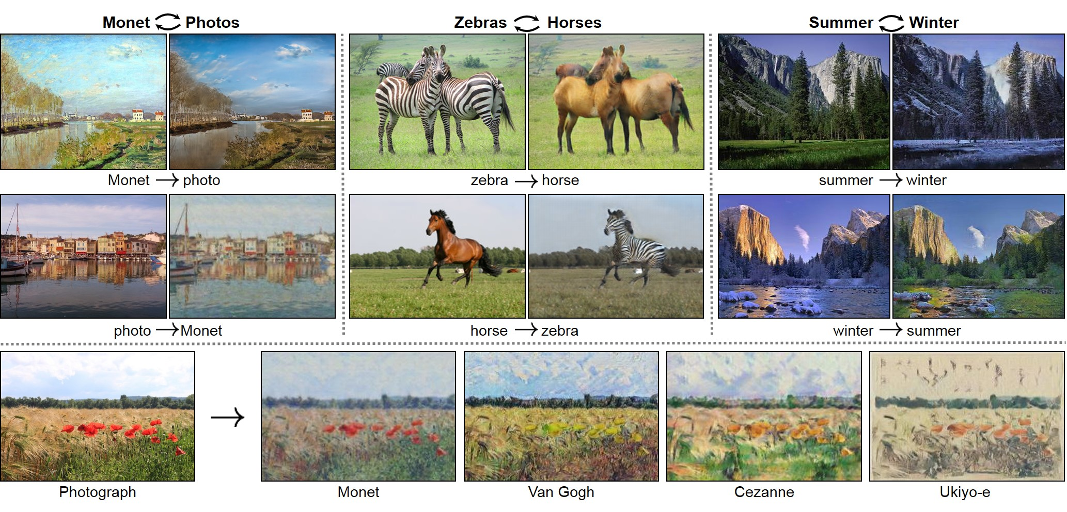
cycle GAN
CycleGAN is a powerful model for generating new images from existing ones.
It uses two generative adversarial networks (GANs) to learn the mapping between two domains of images. The model is trained to capture the characteristics of the target domain and to generate new images from the source domain that share the same characteristics.

Slide 7
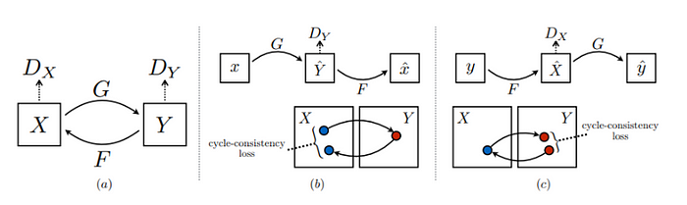
Cycle GAN
The generators of the two GANs form the generators of the CycleGAN, and the discriminators of the two GANs form the discriminators of the CycleGAN. The model is then trained to generate an image from the source domain that is similar to an image from the target domain and vice versa.
The model is initialized by training the two GANs separately
First, the generator of the first GAN is trained to generate a target domain image from a source domain image. The discriminator of the first GAN is trained to identify real target domain images from generated target domain images.
the generator of the second GAN is trained to generate a source domain image from a target domain image.
The discriminator of the second GAN is trained to detect real source domain images from generated source domain images. Once the two GANs have been trained separately, the CycleGAN is defined.

Slide 8
Application of cycle GAN
The CycleGAN is trained using a cycle-consistent loss, which encourages the model to generate images that are indistinguishable from real images from the target domain
The model is further improved by adding an identity mapping component. This component helps to preserve the characteristics of the source domain images when they are translated to the target domain.
The top 5 CycleGAN applications
Image-to-image translation: from sketches to photographs
Domain adaptation:This is often used to adapt models trained on synthetic data to real data.
Data augmentation::This can be used to generate new data from existing data. This can be useful for increasing the size of a training dataset.
Denoising: This can be used to remove noise from data. This is often used in image and audio applications.

